Slide 1
Unit Testing How to write meaningful unit tests with ease
Tomasz Mozolewski
@2010

Slide 2
Main topics
What is unit testing
Programming to interfaces
Testing Java Beans
Testing DAO (Data Access Object)
Testing Services

Slide 3
What is unit testing
Test single class in isolation
No dependencies outside of testing framework

Slide 4
Where does unit testing fit?
Production Test
Load Test
User Acceptance Test (UAT)
Integration Test
Unit Test
Compiler Test
COST

Slide 5
Why unit testing is important
Catch bugs early
Refactoring with confidence
Forces you to think when you write code (How will I test it?)
Encourages usage of best practices (coding to interfaces)

Slide 6
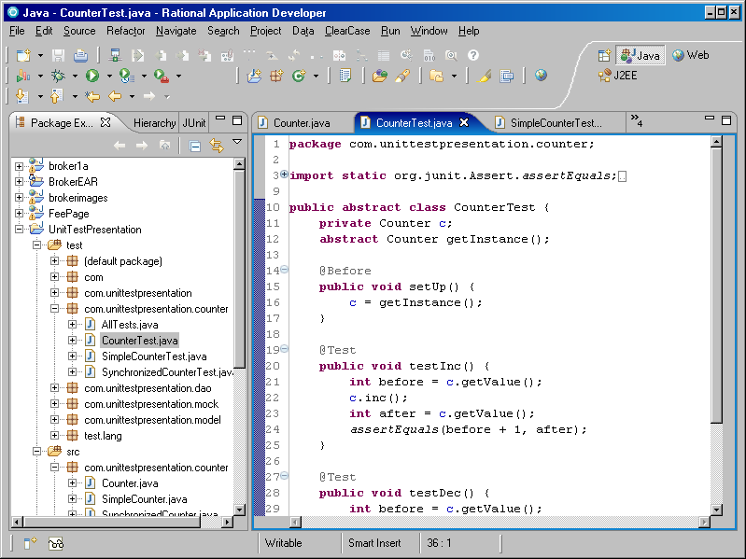
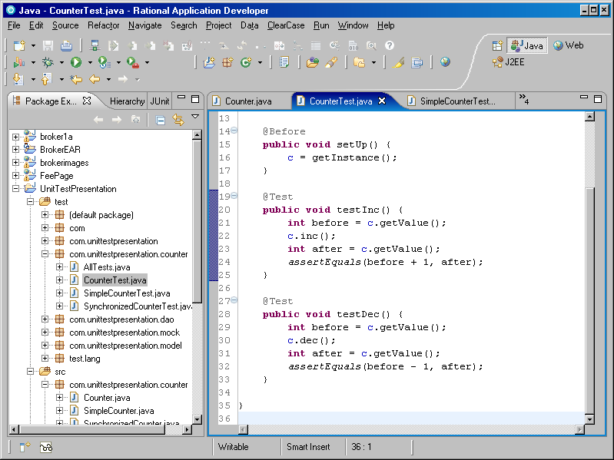
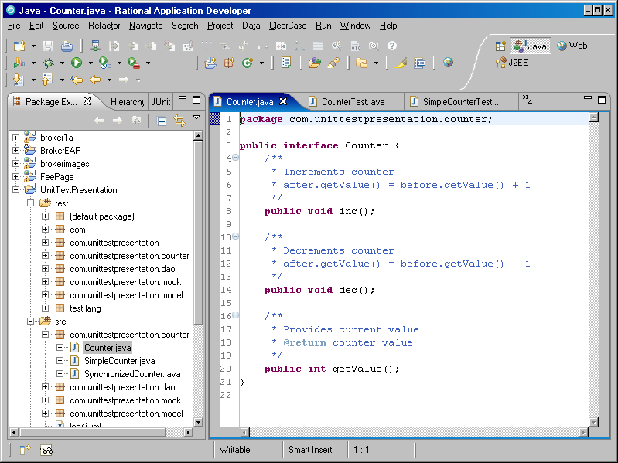
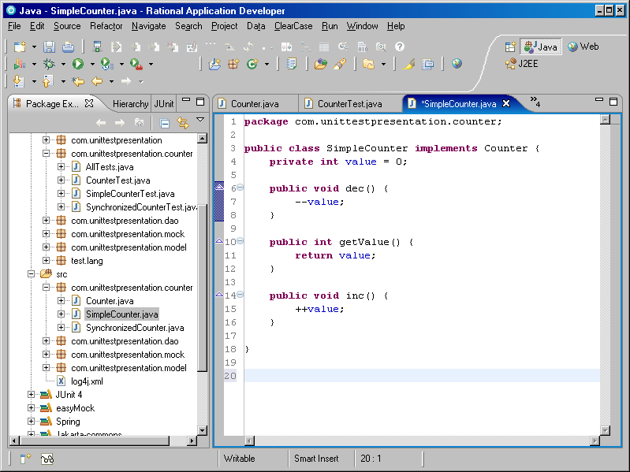
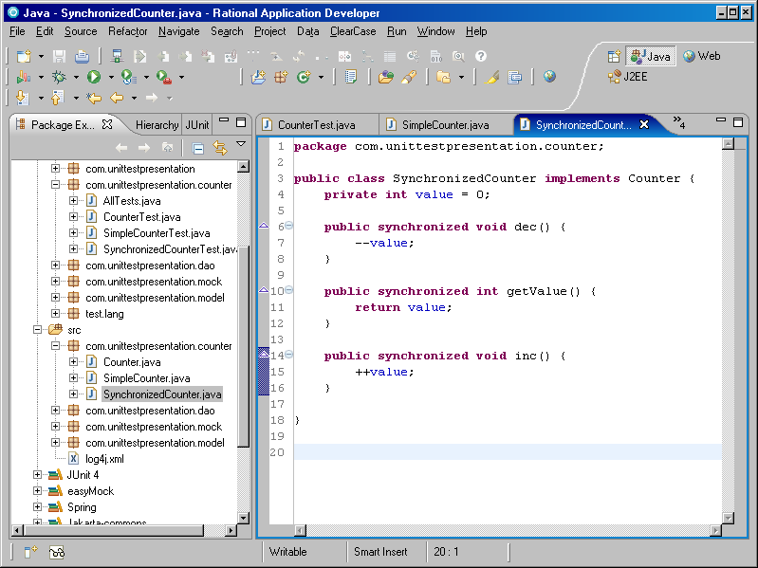
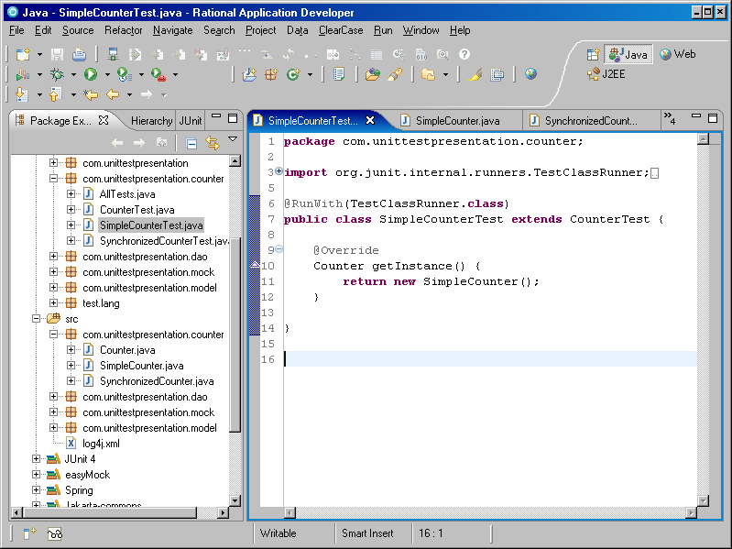
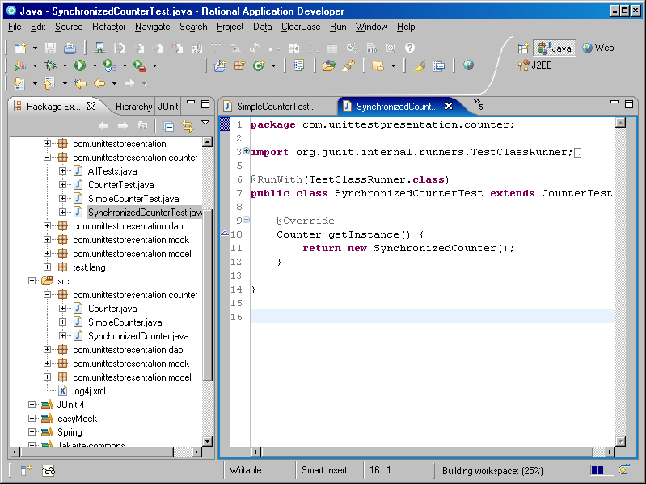
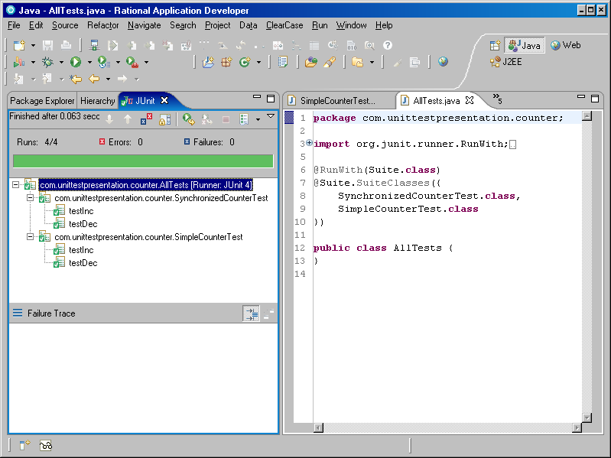
Programming to interfaces
Writing interfaces
Method declaration
Documentation
Interface programming example (Counter.java)
Interface testing (CounterTest.java)
Completeness of interface (testability)
Concrete implementation test (SimpleCounter[Test].java and SynchronizedCounter[Test].java)

Slide 7
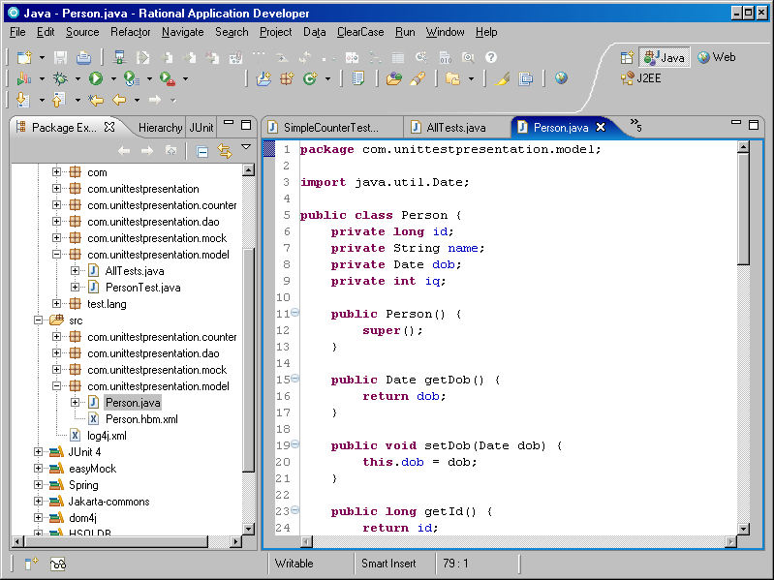
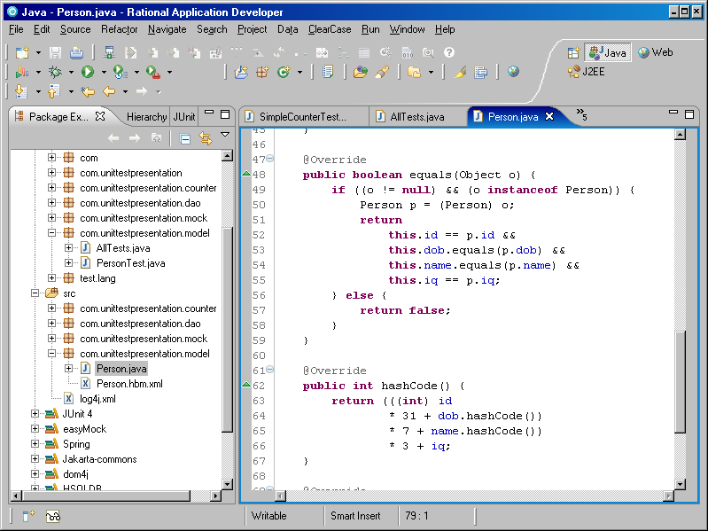
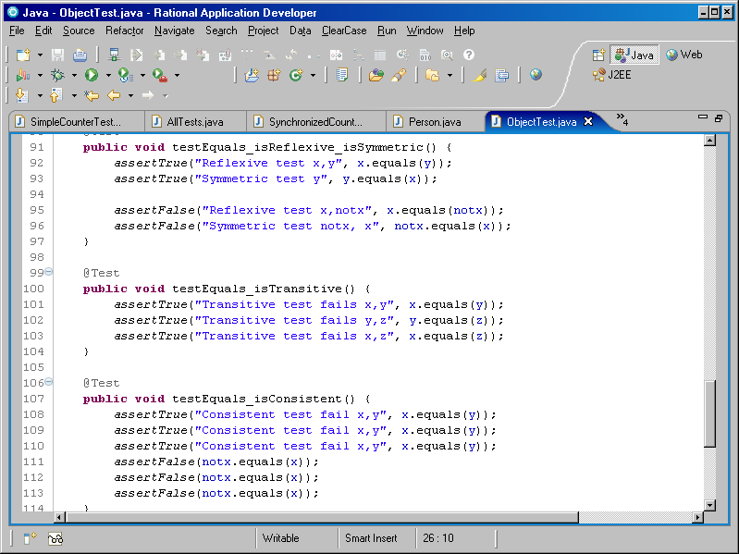
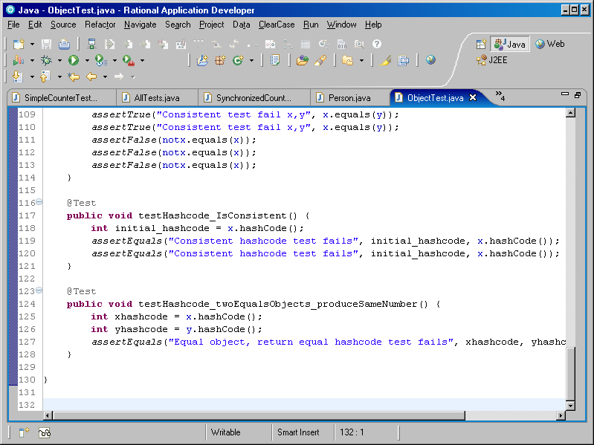
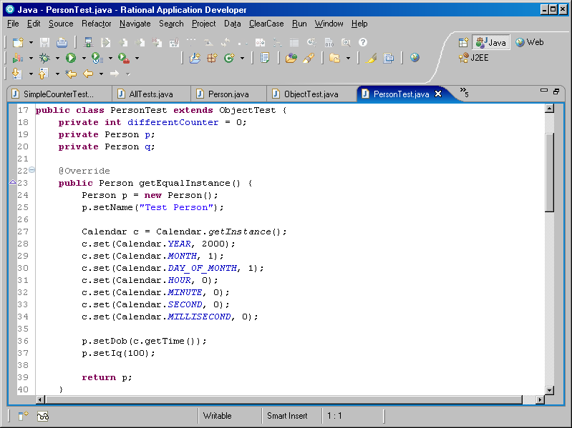
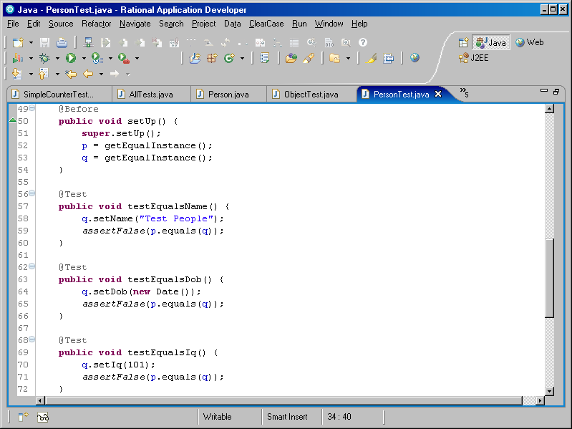
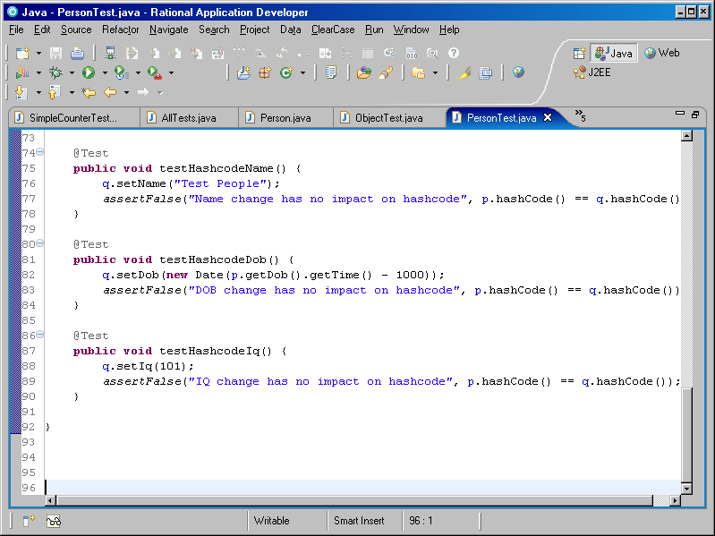
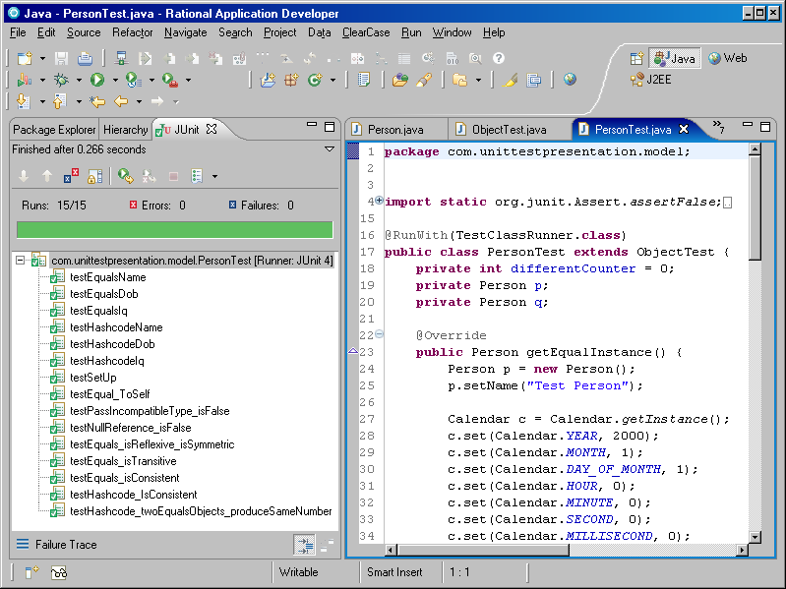
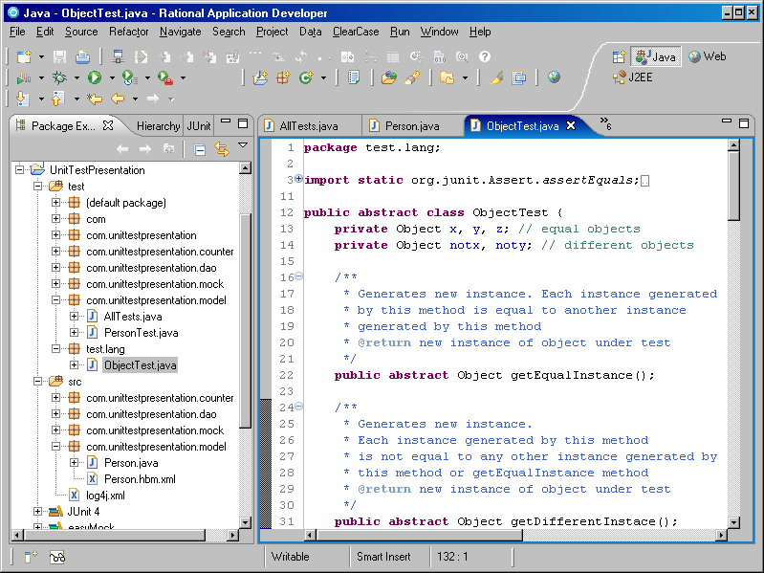
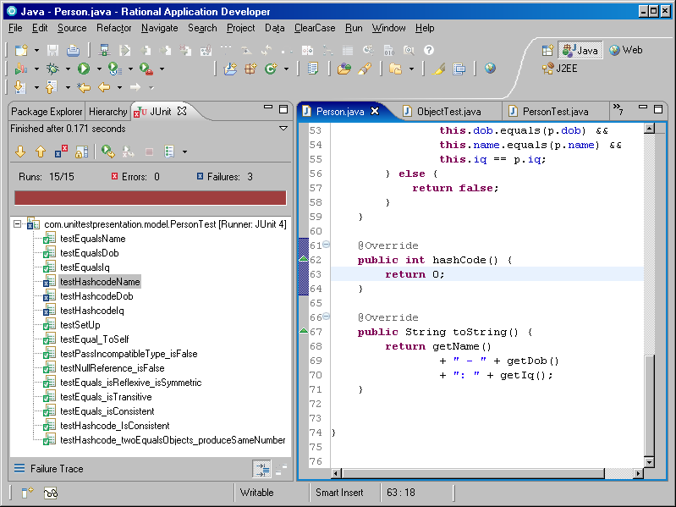
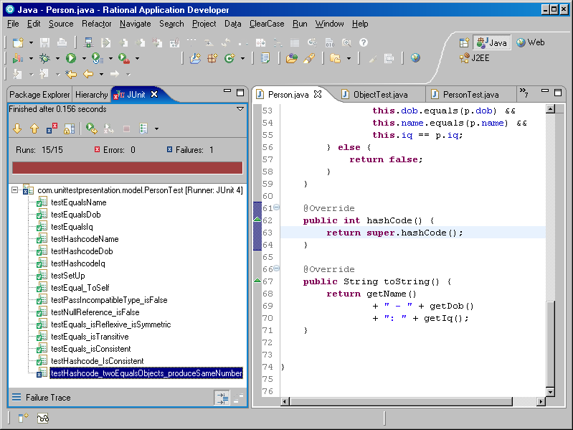
Testing Java Beans
What can go wrong in a simple bean (Person[Test].java)?
Object methods: equals and hashcode (ObjectTest.java)

Slide 8
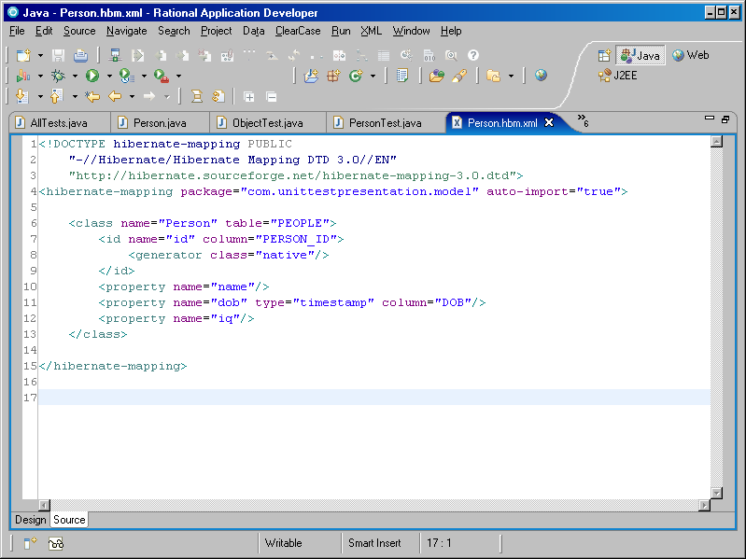
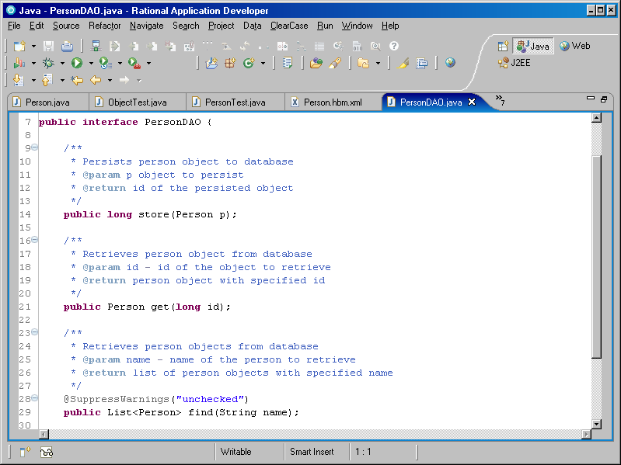
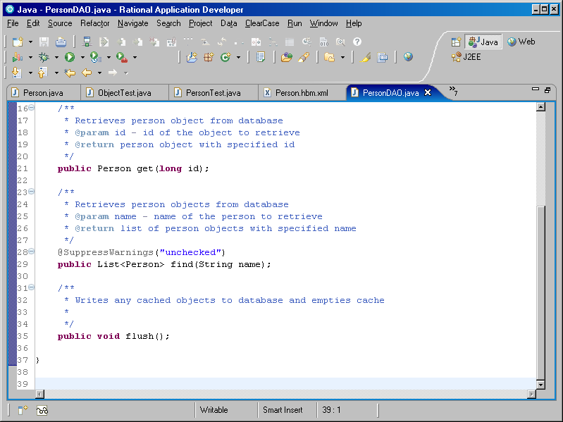
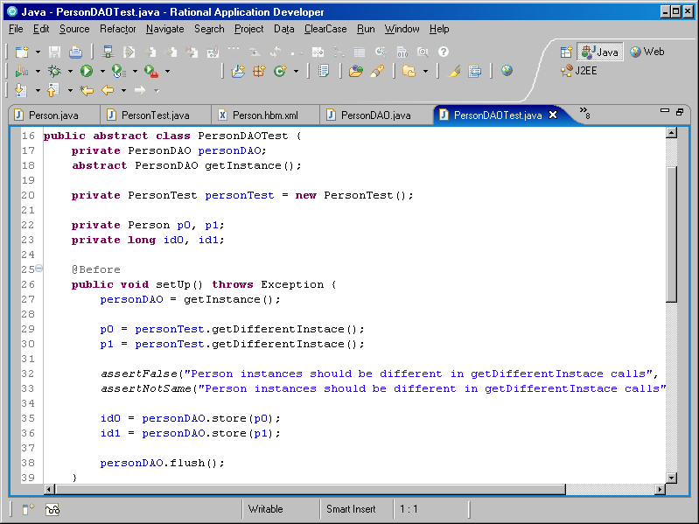
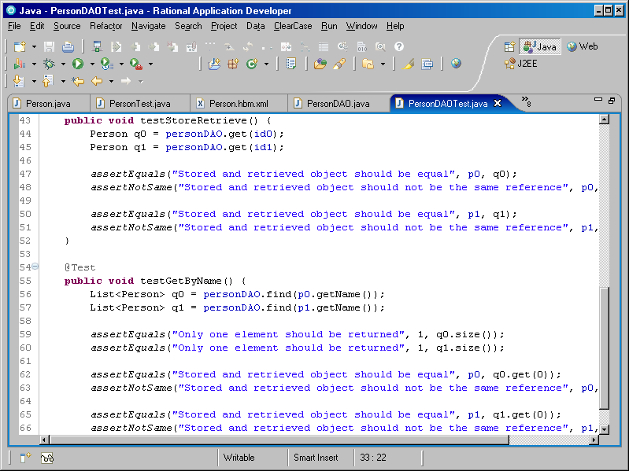
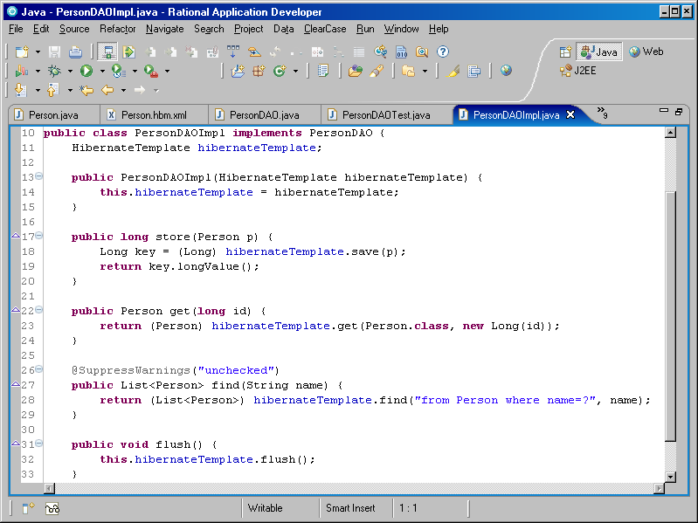
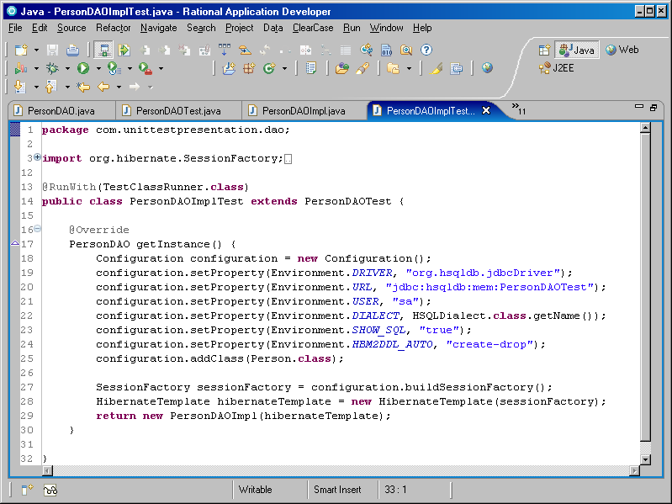
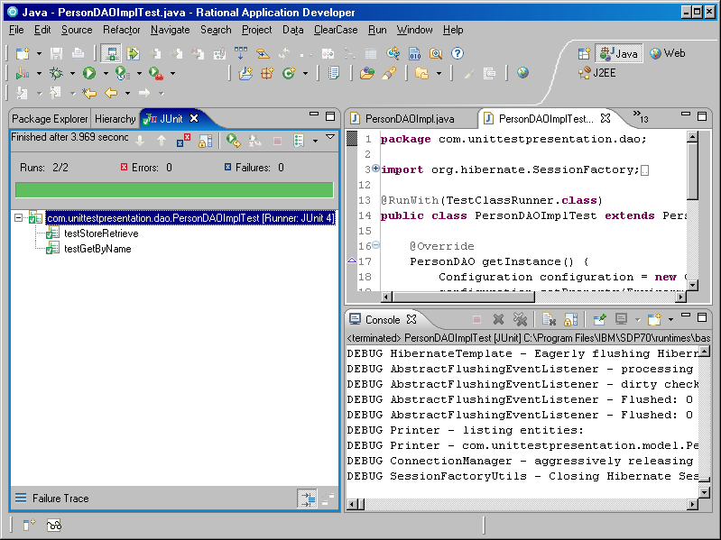
Testing DAO (Data Access Objects)
Hibernate and HSQLDB (in memory database)
Hibernate mapping (Person.hbm.xml)
DAO Interface (PersonDAO[Test].java)
Why flush() method?
DAO Implementation (PersonDAOImpl[Test].java)
In memory database (HSQLDB)

Slide 9
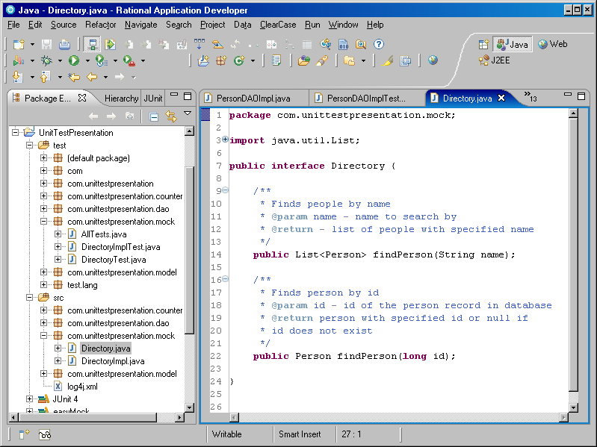
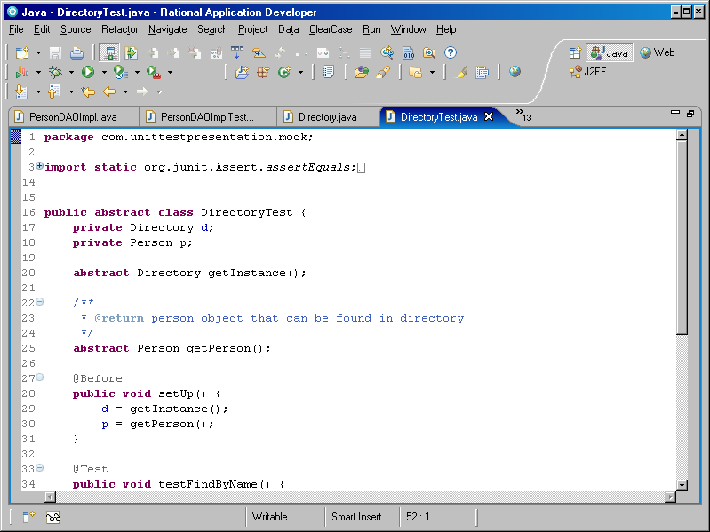
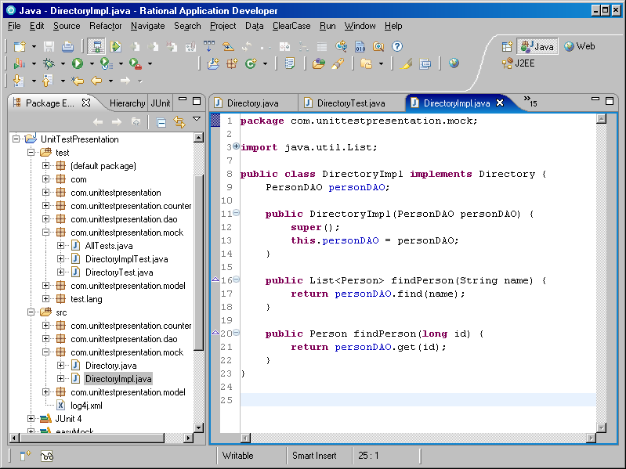
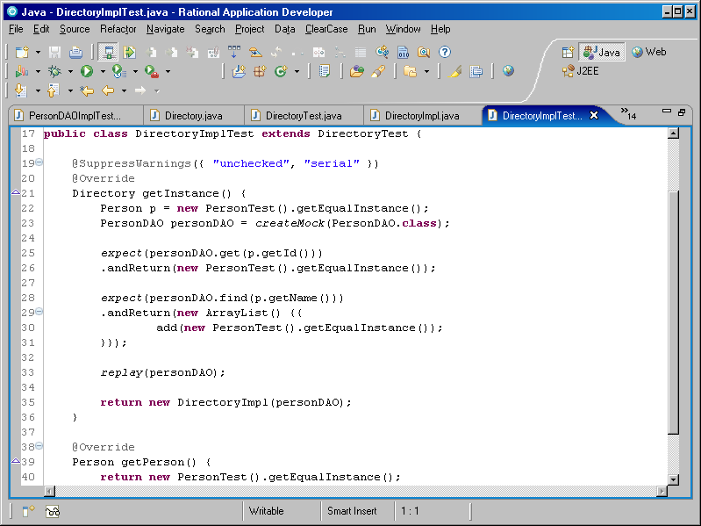
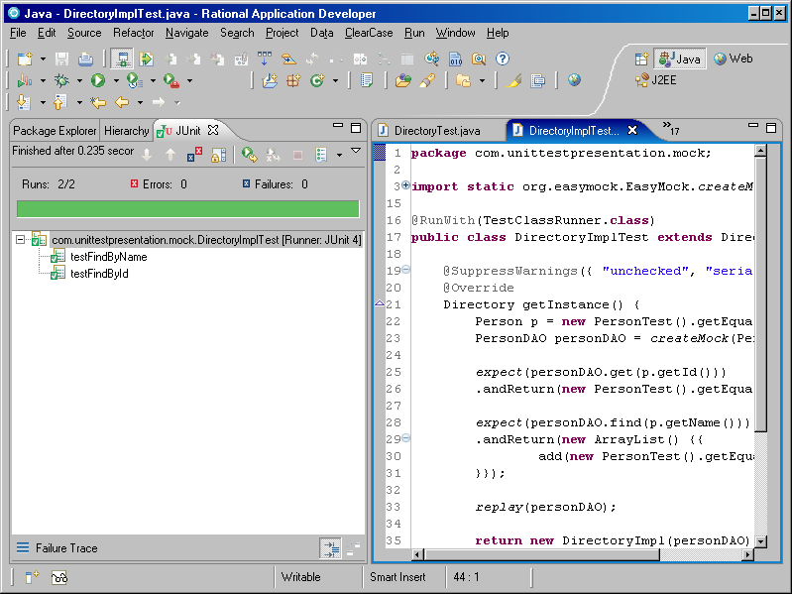
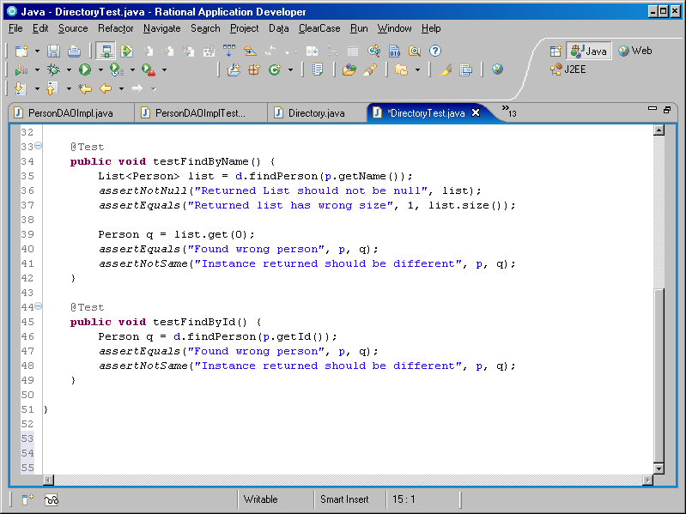
Testing Services
Interface (Directory[Test].java)
Spring and Dependency Injection (DirectoryImpl.java)
EasyMock and Interfaces (DirectoryImplTest.java)

Slide 10
Code writing steps
Interface
Interface Test
Implementation
Implementation Test

Slide 11
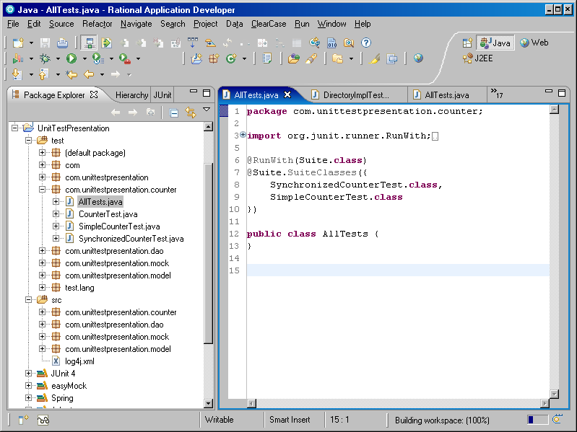
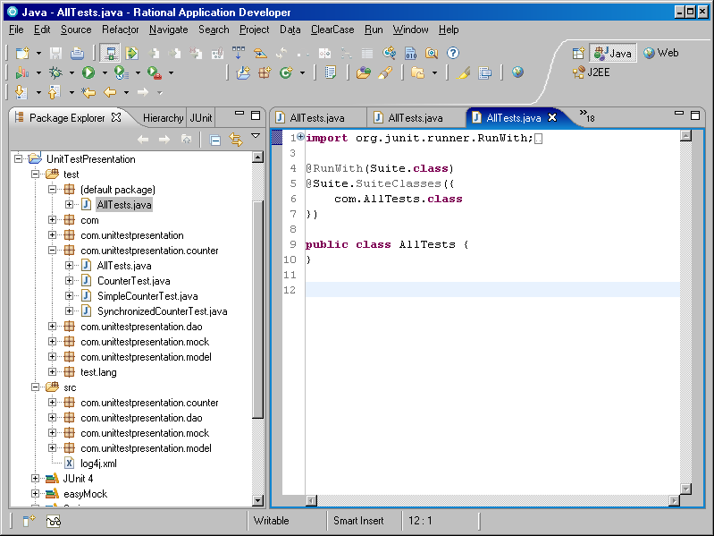
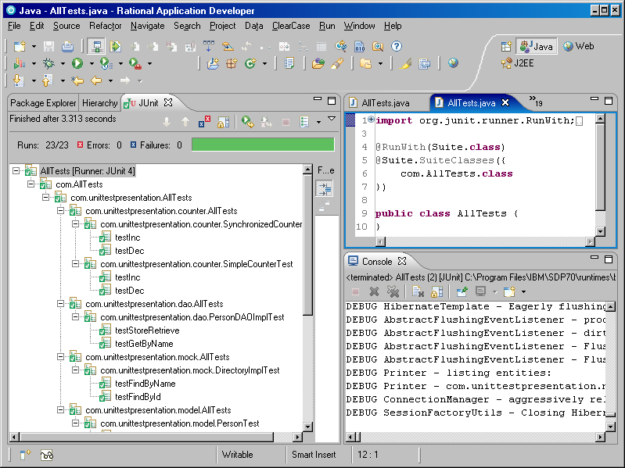
Other thoughts
Test Suites (AllTests.java)

Slide 12
Reference
Framework | Home | Tutorial / Cookbook | JavaDoc
JUnit | http://www.junit.org | http://junit.sourceforge.net http://junit.sourceforge.net/doc/cookbook/cookbook.htm | http://junit.sourceforge.net/javadoc
Easy Mock | http://easymock.org | http://easymock.org/EasyMock2_5_2_Documentation.html | http://easymock.org/api/easymock/2.5.2
Spring | http://www.springsource.org | http://www.theserverside.com/tt/articles/article.tss?l=SpringFramework | http://static.springsource.org/spring/docs/3.0.x/javadoc-api
Hibernate | https://www.hibernate.org | https://www.hibernate.org/152.html http://docs.jboss.org/hibernate/stable/core/reference/en/html_single | http://docs.jboss.org/hibernate/stable/core/api
HSQLDB | http://hsqldb.org | http://www.hsqldb.org/doc/2.0/guide | http://hsqldb.sourceforge.net/doc/src
Log4j | http://logging.apache.org/log4j/1.2 | http://logging.apache.org/log4j/1.2/manual.html http://wiki.apache.org/logging-log4j/Log4jXmlFormat | http://logging.apache.org/log4j/1.2/apidocs
JUnit Anti-patterns
http://www.exubero.com/junit/antipatterns.html

Slide 13
Libraries
JUnit (http://sourceforge.net/project/showfiles.php?group_id=15278&package_id=12472)
junit-4.1.jar
Easymock (http://sourceforge.net/projects/easymock/files/EasyMock/2.5.2/easymock-2.5.2.zip/download)
easymock-2.5.2.jar
Spring (http://s3.amazonaws.com/dist.springframework.org/release/SPR/spring-framework-3.0.0.RELEASE.zip)
dist/spring.jar
lib/antlr/antlr-2.7.6.jar
lib/cglib/cglib-nodep-2.1_3.jar
lib/dom4j/dom4j-1.6.1.jar
lib/hibernate/hibernate3.jar
lib/hsqldb/hsqldb.jar
lib/j2ee/jta.jar
lib/jakarta-commons/*.jar
lib/log4j/log4j-1.2.15.jar
lib/slf4j/*.jar

